Slide 1


Presentation On CV and Cover letter
Presented by
MD. Jaynal Abdin _191902055
MD. Gias Uddin _191902054
Sanjida Alomgir Kona _191902011
Md Mohosin Khan _191902010
Rakib Mia _191902063

Slide 2
Contents
What is CV?
When should we use a CV?
How long should a CV be?
What information should a CV include?
How to write a good CV?
What is Cover letter?
Objectives
What information should include in Introductory?
What information should include in Middle Paragraph?
What information should include in Closing?

Slide 3

What is CV?
A CV is a short description of the persons educational and professional history.

Slide 4
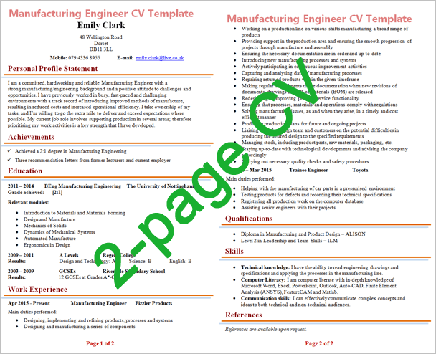
When should we use a CV?
When we are applying for a job at interviews
CV should short not longer than two pages.

Slide 5
What information should a CV include?
Personal Information
Work Experience
Education
Skills and Interest

Slide 6
What information should a CV include?
Personal Information
Name and surname
Date of Birthday
Address
Email address
Telephone Number with Country code
Formal Picture

Slide 7
What information should a CV include?
Work Experiences:
Here, we should add our work experiences where we were work before or still now working.
Work place name
Position
Duration

Slide 8
What information should a CV include?
Education:
Institution Name
Passing Year
Result

Slide 9
What information should a CV include?
Skills And Interests:
Communication skills
Computer skills
Technical skills
Organization skills
Other skills

Slide 10
How to write a good CV?
Short
Easy to read
Logical ordered
Not small or not big
Avoid spelling or grammar mistake
Should use proper font and font size
Avoid writing whole sentences/Short Sentences

Slide 11
Cover Letter
Job application letter is the cover letter for your job application
Is accompanied by your CV
Identify your most relevant skills or experiences
Job application letter- a complement but not duplicate a CV/resume
Express a high level knowledge about the position

Slide 12
Objectives
To introduce yourself
To ask for interview
To Draw attention to relevant qualifications and experiences.
To match what you have to offer and the potential employer needs.
To persuade your future employer to consider the application carefully.

Slide 13
Guidelines
Three important issues should follow:
1. First paragraph:
Why you are writing to the organization
2. Middle paragraph:
What you have to offer?
3. Concluding paragraph:
How you will flow up?

Slide 14
First paragraph
If it an advertise position mention the position where it was advertised.
For example:
I wish to apply for the position of the Software Engineer

Slide 15
Middle Paragraph
Tell them what you have to offer.
Why they should read your CV?
Summarize your experiences and skills.
Respond to the position requirements as per the advertisement
Should tell you on some unique points that you might have.

Slide 16
Closing paragraph
Should ask for some action from the recipient.
Provide contact number, email address to ease reader to you.
Should thank the recipient giving opportunity to apply.
Leave space for signature
Write your full name

Slide 17


Slide 18


